Slide 1

MPPT For Wind Turbines
Using DNN and P&O

Slide 2
01
Introduction

Slide 3
In this project, we have trained a Deep Neural Network (DNN) model to predict the optimal pitch angle of the blades and a P&O Simulink model to predict the maximum power output.
Pitch angle predicted on the basis of wind speed, wind angle, flow angle and angular velocity of the turbine.
The output of the DNN model will be given as input to the Simulink model.

Slide 4
02
Literature Review

Slide 5
Y. Ando, et.al “Maximum power point tracking control method for the small wind power generation system corresponding to wind speed variation,” was our reference paper.
They used hill climbing algorithm to find the input power.
Load torque is adjusted incrementally and power before and after adjustment is compared to track MPP.
If the difference between turbine and generator torque is large, the torques are made to match each other to improve transient response.

Slide 6
Their system uses PMSG with vector control, a bi-directionals chopper and a battery manage DC voltage for stable power output.
The power is converted to single phase AC for load supply.
Their simulation had good efficiency during constant wind speed.

Slide 7
03
Research Gaps

Slide 8
The model proposed in the existing research paper works efficiently during constant wind speed.
But the efficiency drops when it is fluctuating .
Also the proposed model does not include any AI model.

Slide 9
04
Objectives

Slide 10
Accurately predict the optimal pitch angle using DNN.
Integrate the DNN model with the traditional model to obtain maximum power output.
To compare the results obtained by traditional MPPT methods and the AI hybrid model.

Slide 11
05
Methodology

Slide 12
Deep Neural Network (DNN)
DNNs are powerful ML models designed to automatically learn complex patterns from data.
It consists of an input layer, multiple hidden layers for computation and an output layer.
The output layer’s output is based on regression.

Slide 13
The DNN model takes wind speed, wind direction, flow angle and turbine angular velocity as inputs and gives the optimal pitch angle as output.
The dataset is split into 80% training and 20% testing.
The final R^2 score obtained is 95.7%

Slide 14
Perturb & Observe (P&O)
P&O is widely used MPPT method for renewable energy systems like photo voltaic devices and wind turbines.
Its main functionality is to adjust the system’s operating point to extract maximum power.
The algorithm periodically perturbs a control variable like current, voltage or duty cycle (in our case) and observes the output power.

Slide 15
Step | Duty Cycle(D) | Power | Decision
1 | 50% | 42 W | Increase D
2 | 52% | 43.5 W | Keep increasing
3 | 54% | 44 W | Keep increasing
4 | 56% | 43.7 W | Power dropped, reverse
5 | 54% | 44,2 W | Better

Slide 16
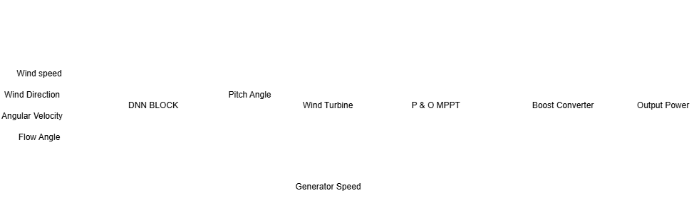

Slide 17
06
Results

Slide 18
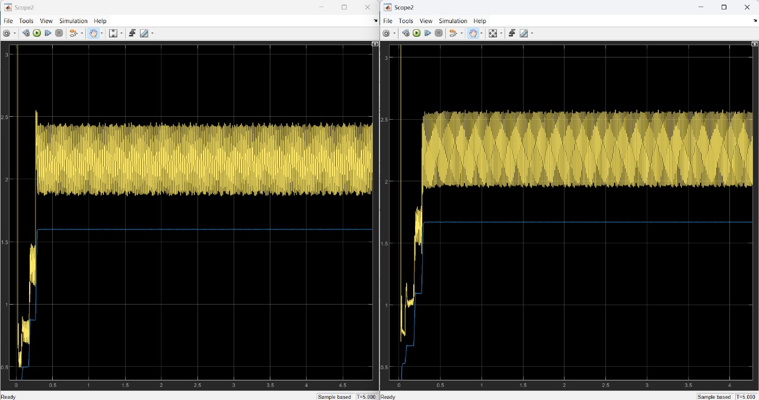
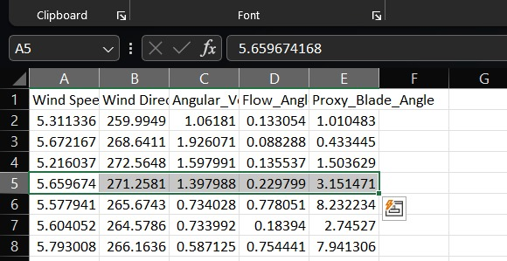

Slide 19
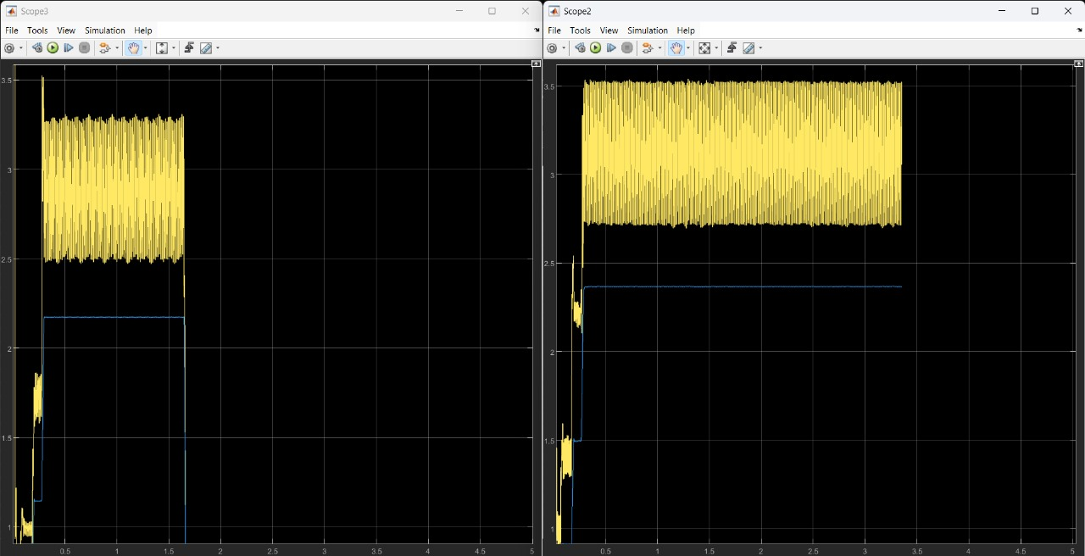
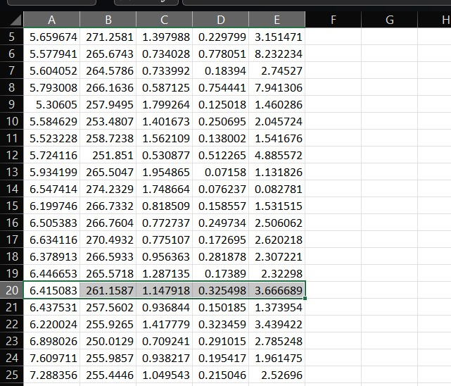

Slide 20
07
Conclusion

Slide 21
As seen in the results, we have compared the output difference between traditional MPPT systems and AI hybrid systems.
The AI enabled model gave better MPPT outputs
These models can be applied in large scale wind farms to extract maximum power.

Slide 22
08
Refernces

Slide 23
Y. Ando, N. Yamamura, and M. Ishida, “Maximum power point trackingcontrol method for the small wind power generation system correspondingto wind speed variation,” in 2020 23rd International Conference onElectrical Machines and Systems (ICEMS), pp. 1008–1011, IEEE, 2020.

Slide 24

1. Anantha Krishna SK - CB.SC.U4AIE24102 2.M Sri Ram Krishna - CB.SC.U4AIE24127 3. T Devi Sri Soumith - CB.SC.U4AIE24155 4. Yogesh JK - CB.SC.U4AIE24161
Thank You

